Slide 1
Collaborative Platform
Ricardo Dominguez – Developer
Juan Caraballo – Mentor
Dr. Masoud Sadjadi - Instructor

Slide 2
Problem
There is currently a lack of one-to-one interaction between students and professionals.
Students have to rely on several sources in order to get their answers.
Many of the times students ask questions, it can take days or even weeks for the questions to be answered.
Professionals currently lack an accessible way to mentor students in their line of work.

Slide 3
Current system
Ticket creation and management
Mentor Application
Mentee Interaction through Video Conferencing
Mentee and Mentor Feedback
Complete set of Functional and Unit Tests
Reports that monitor mentee and mentor activity

Slide 4
Problems Solution
The application lacks a way to convey user feedback to the administrators.
There is very little testing done as far as automatic testing is concerned.
System expansion is currently very limited to the current framework.
Ability for users to give administrators feedback through the application.
Code a series of functional and unit tests that can act as code coverage for the system.
Using the tests, programmers can add and take away from the system while ensuring the application is functioning as intended.

Slide 5
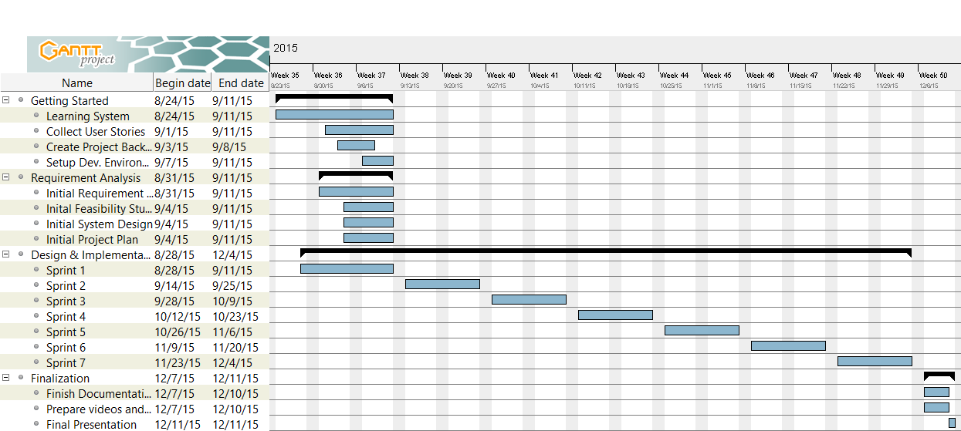
Project Management

Slide 6
Implemented user stories
Implemented User Stories
Feedback Create – Allows users to create Feedback
Feedback Delete – Allows the administrator to delete posted Feedback
Reply to Feedback – Allows administrators and Feedback authors to create replies on posted Feedback.
Add to Feedback – Allows Feedback creator to add to his original feedback.
Manage Feedback – Allows Administrator to manage posted feedback.
View Feedback – Lets users view other user feedback
Write User unit and Functionality Tests
Write Mentor Unit and Functionality Tests
Write Ticketing Unit and Functionality Tests
Write Video Conference Unit and Functionality Tests
Write Report User and Functionality Tests
Write Messaging User and Functionality Tests
Write Notification and Report Functionality Tests

Slide 7
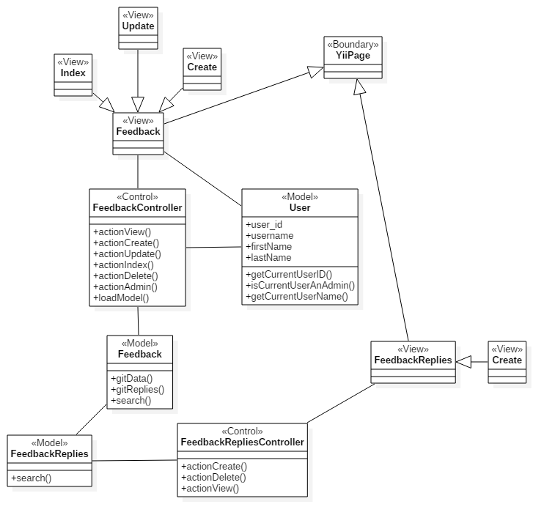
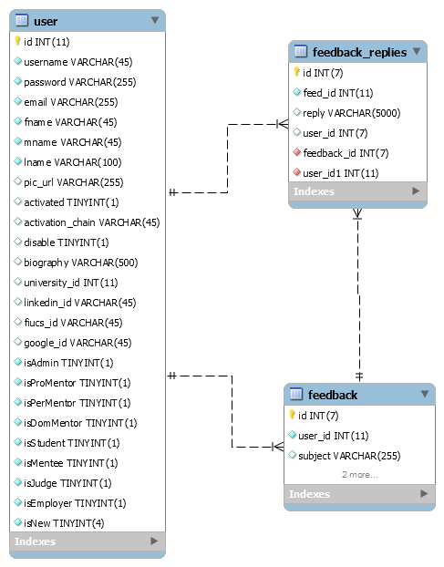
Class Diagram
ER Diagram

Slide 8
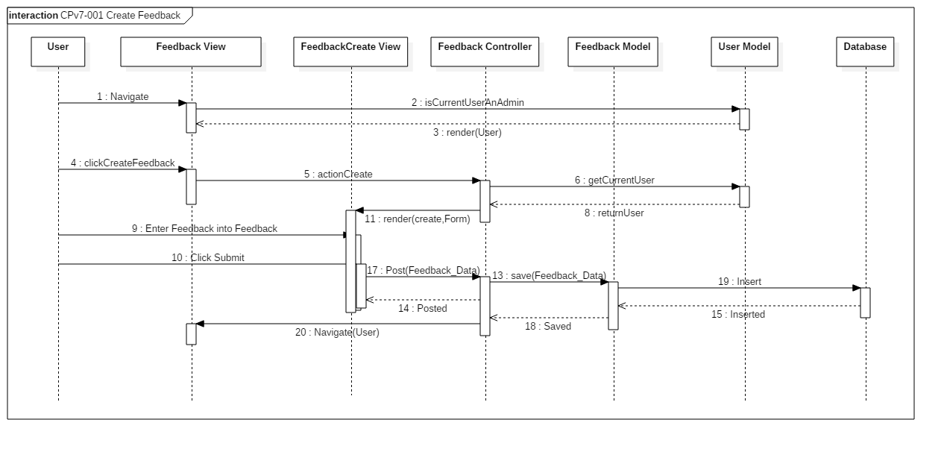
Sequence Diagram

Slide 9
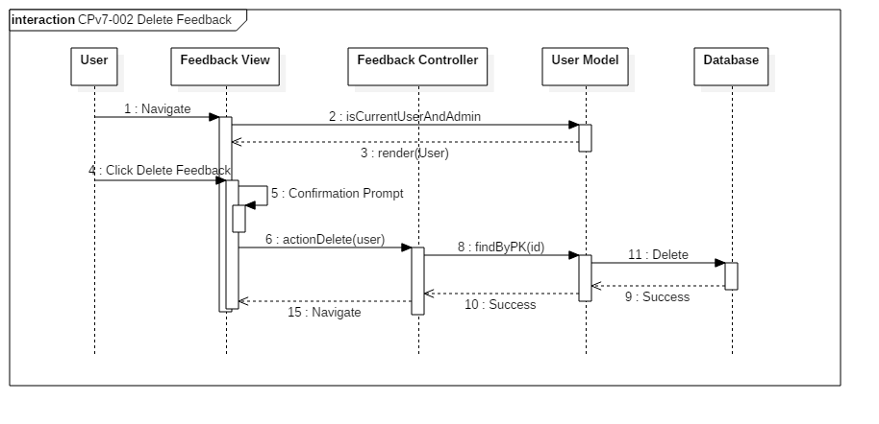
Sequence Diagram

Slide 10
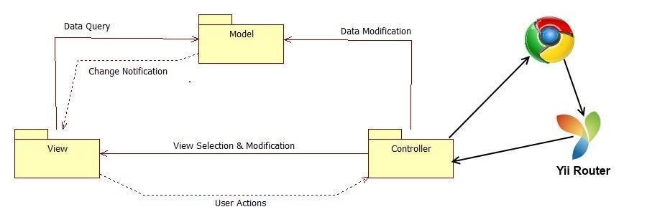
System decomposition

Slide 11
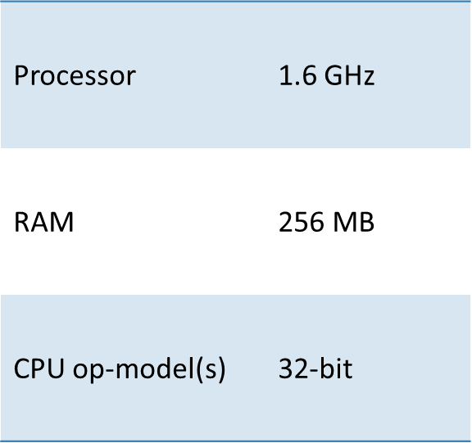
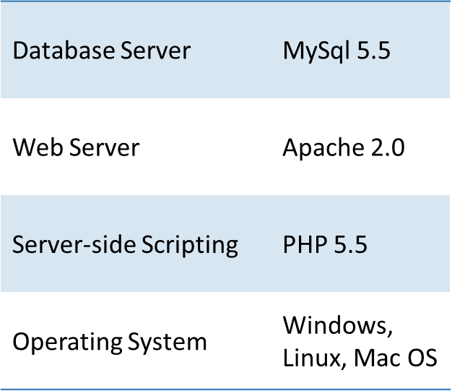
System deployment
Minimum Hardware
Minimum Software

Slide 12
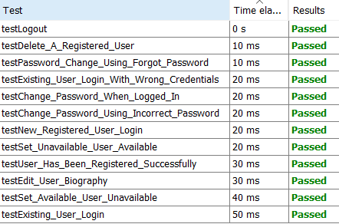
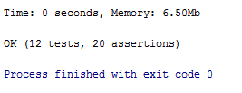
Unit testing
Done with PHPUnit 5.1
Tests current system as well as Feedback implementation
Benefits –
Allows developers to update current code with ease
Shows us current weaknesses within our code or areas that require refactoring.
Improves code by making it testable
Helps the developer better understand the code.

Slide 13
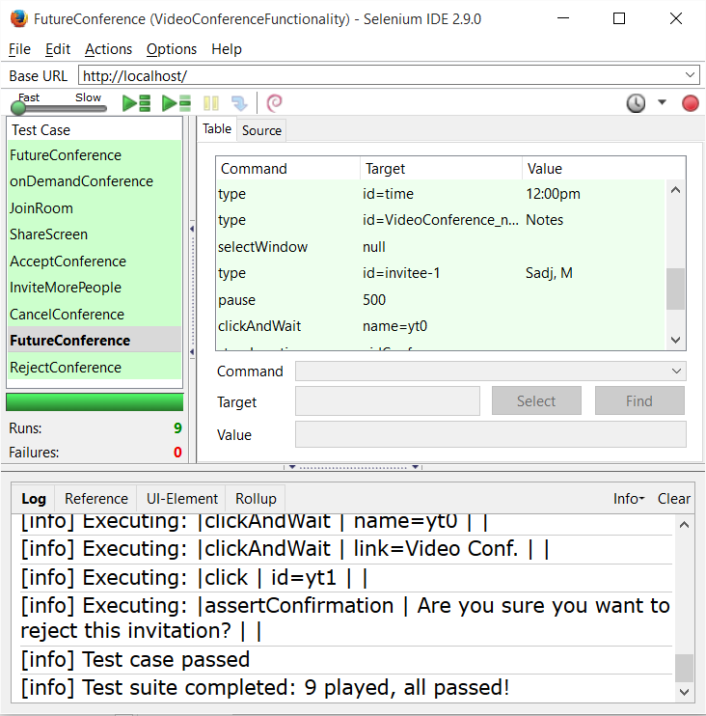
Functionality testing
Done with Selenium IDE (non-licensed)
Test current system’s front end to ensure that all sub-systems are working as intended to the users.
Benefits –
Allows for easy code updating by making sure that any code added or taken away will work as it is intended.
Easy to update – Selenium IDE has become an industry standard because of its user friendliness and wide variety of coverage.
Simulates user interaction and ensures that that different user stories work as intended.

Slide 14
Thank you!
Contact Information
rdomi005@fiu.edu
Questions?
Comments?
Concerns?

